Slide 1
DISRUPTIVE INNOVATION: The CASE OF THE MUSIC INDUSTRY
Robert C. Vackar College of Business and Entrepreneurship

Slide 2
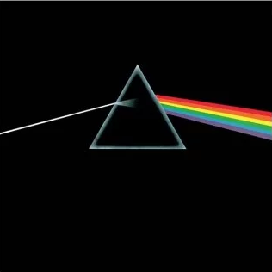
Music Industry 1967
Analog media
Recording Studio, tape
Vinyl pressing, factory reproduction
Physical distribution: trucks, pallets
In-store sales only
Artists, agents, A&R, record companies
MARKETING: live tours, Radio play
Quality – surface noise, limited range

Slide 3
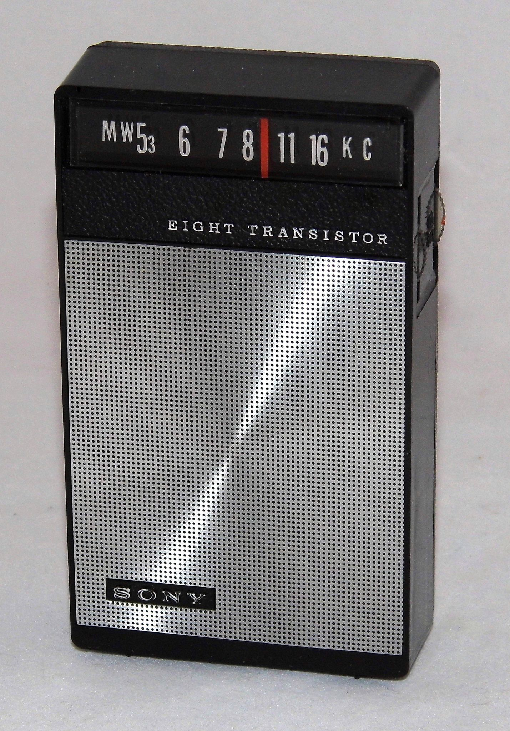
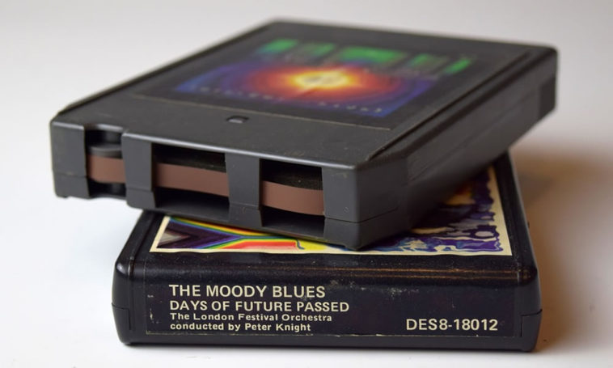
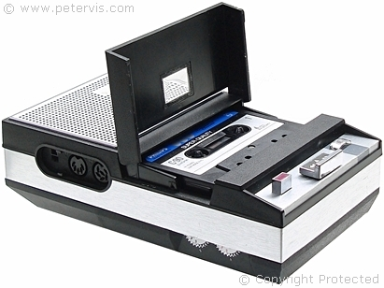
Hardware Innovations 1
Stereo LP: $6 1975 / $29 2019
45’s: ( (singles)
PORTABILITY
Transistor radio
8-track tape
Cassette tapes and reel-to-reel
Sony Walkman + headphones

Slide 4
Hardware Innovations 2
DIGITAL TRANSFORMATION
Money, mail, cars, maps, books – Music!
Music CD $16.99 1981 ($48 in 2019!)
CD Player
Minidisc player/recorder
QUALITY : zero-noise, perfect reproduction

Slide 5
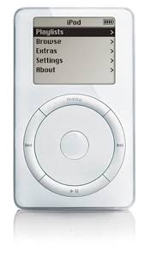
Software Innovations 1
MP3 MPEG Layer 3: data compression
5 minute song CD = 55 MB, MP3 = 5MB
Severe quality loss ~ high quality cassette
PORTABLE
Hardware + Software Innovation:
iPod

Slide 6
Software Innovations 2
MP3 ‘ripping’ software
Media player software (for computers)
Music recording and editing software
Audacity – open source (free???)
INTERNET
Peer-to-peer networks

Slide 7
DISRUPTION
Music CD + ripping software + MP3 + iPod + Internet + peer-to-peer networks =
NAPSTER – many-to-many
Limewire, Kazaa – distributed catalog
Bittorrent (Pirate Bay) – distributed files
Piracy – violation of intellectual property copyright law

Slide 8
Music Industry Fights Back
LiquidAudio – “protected” digital audio
SuperAudio CD – “protected” digital disk
DVD Audio
Plummeting sales
Rampant piracy
Moore’s Law = easier piracy

Slide 9
Music Industry 2007
Digital media
Recording Studio + Home/independent studios
Factory reproduction + Perfect, infinite reproduction
Physical distribution + Internet digital distribution
In-store sales + E-commerce for CDs *and* MP3’s
Artists, agents, A&R, record companies + independent labels and artist direct sales
Marketing: live tours, Radio play + P2P, and…
YouTube

Slide 10
Software Innovations 3
STREAMING
“Platform” (Windows, Google, YouTube)
Music industry revenues shift to platforms
Spotify, Pandora
Artist royalties plummet (sort of)
Subscription models – iTunes/Apple Music, Amazon Prime, Spotify, Sirius XM, Spectrum, Google Play
‘Transaction Cost’ finally beats piracy (ECONOMICS)

Slide 11
Emergent Consequences
Global Reach: BTS, Psy , Kyary Pamyu, Perfume
Hyperdifferentiation: Thousands of music genres
Dozens of co-existing different business models
ARTIST INNOVATIONS
Sampling: Hip-Hop, EDM, Pop
Remix and Re-use
Parody, Satire, Political commentary

Slide 12
The Future?
Recommender Engines (AI)
Virtual performers
Deep Fakes
Business models that support artists???
PRIVACY

